Slide 1
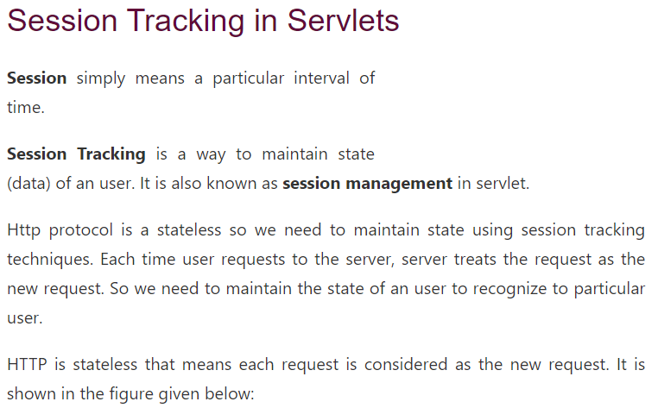

Slide 2
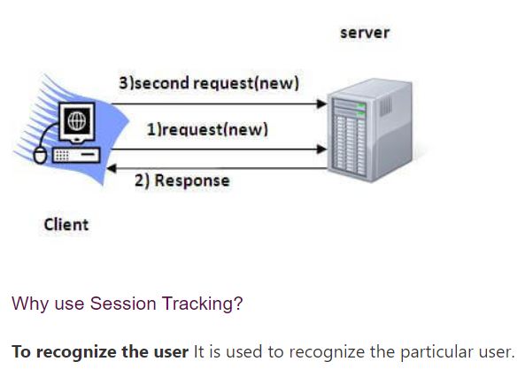

Slide 3
Session Tracking in Servlets
Session simply means a particular interval of time.
Session Tracking is a way to maintain state (data) of an user. It is also known as session management in servlet.
When you are filling the scholarship application
Step1 : college details
Step 2: personal details
Step 3: cast details
Step 4: qualification details
When you are filling the personal details , your
application has to maintain college details information .

Slide 4
To maintain client previous request details at the time of processing later request use session tracking mechanism.

Slide 5
There are three types of session tracking mechanisms
a.HttpSession Tracking mechanism
we will maintain client previous request details at the time of processing later request at server side using HttpSession object.
b. Cookies Session Tracking Mechanism
we will maintain client previous request details at the time of processing later request at server side using Cookies
C. URL Rewriting Session Tracking Mechanism

Slide 6
a. HttpSession Tracking mechanism
we will maintain client previous request details at the time of
processing later request at server side with the help of HttpSession object.
Lets say we have 3 forms
Form1.html
Form2.html
Form3.html

Slide 7
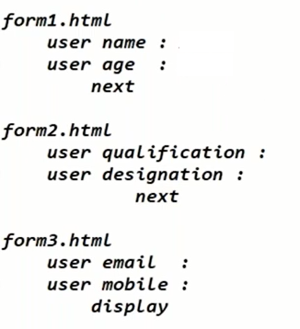

Slide 8
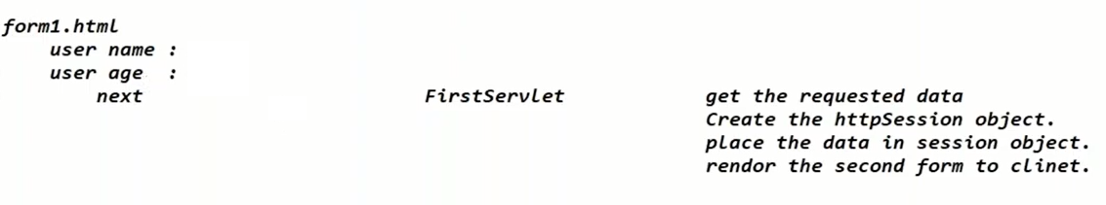

Slide 9
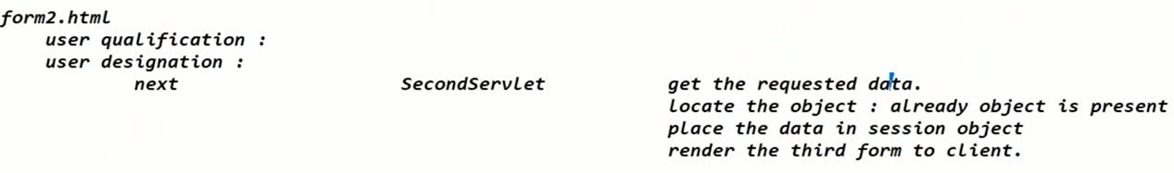

Slide 10
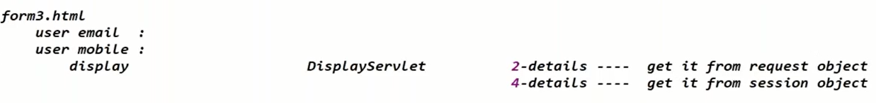

Slide 11
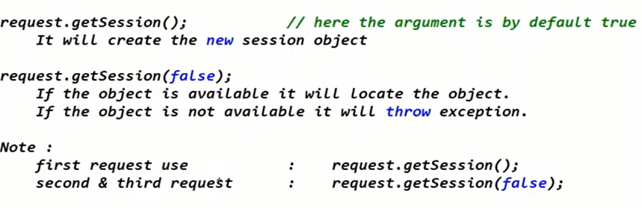

Slide 12
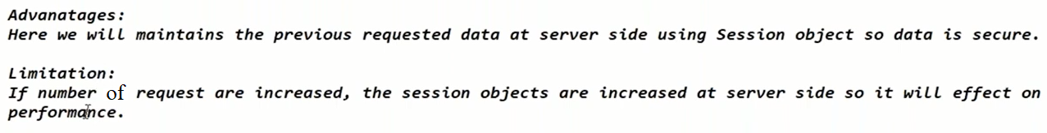

Slide 13
b. Cookies Session Tracking Mechanism
we will maintain client previous request details at the time of processing later request at server side using Cookies
A cookie is a small piece of information that is persisted between the multiple client requests.

Slide 14
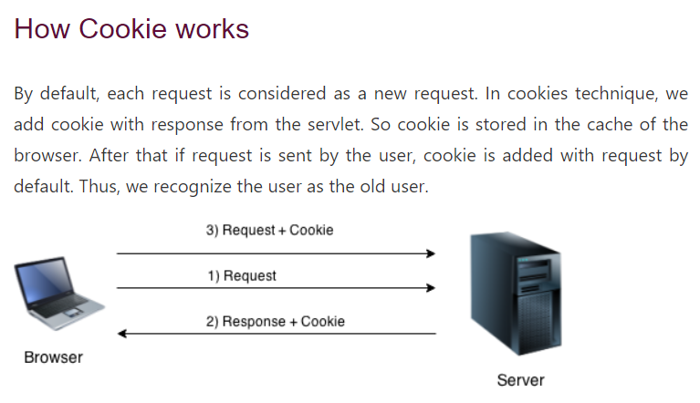

Slide 15
Advantages:
The data is maintained at client side so performance is increased.
limitations:
The data is maintained at client side so it is not secure.
If cookies are disabled this mechanism will not work

Slide 16
https://www.geeksforgeeks.org/the-httpsession-interface-in-servlet/

